Slide 1
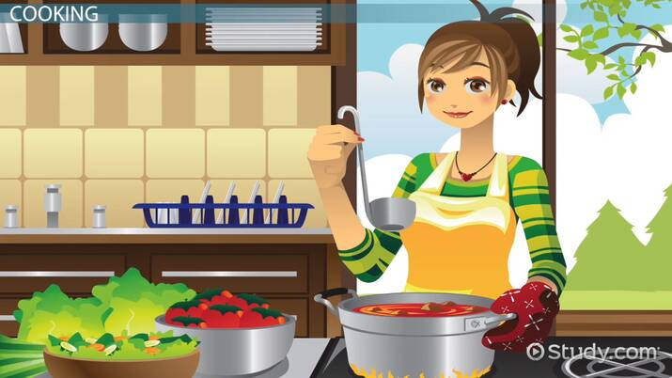
Food preparation:

Slide 2
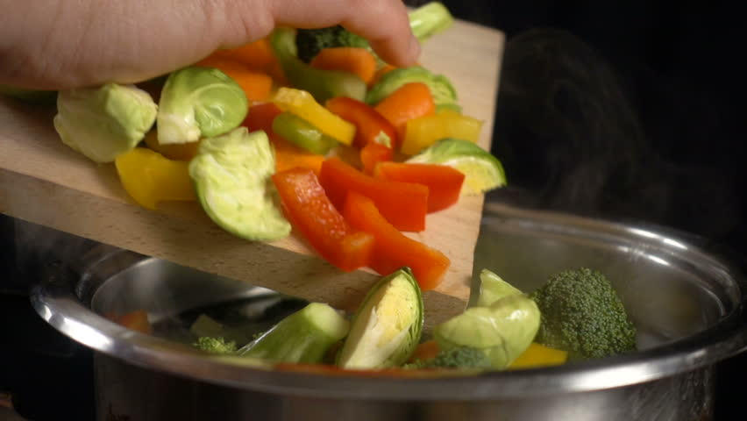
____________________ the vegetable

Slide 3
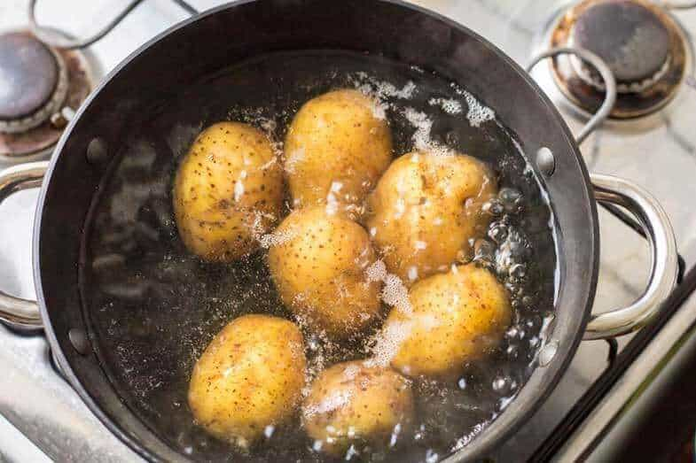
_____________ the potatoes

Slide 4
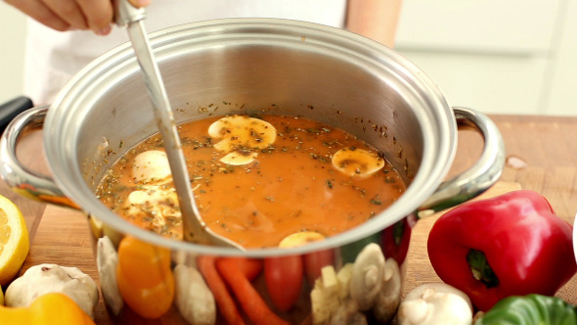
____________ the soup

Slide 5
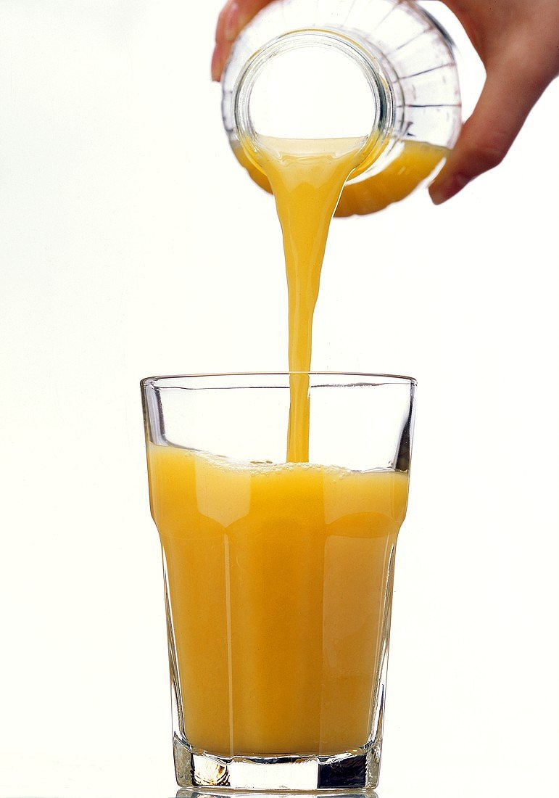
_______________ the juice

Slide 6
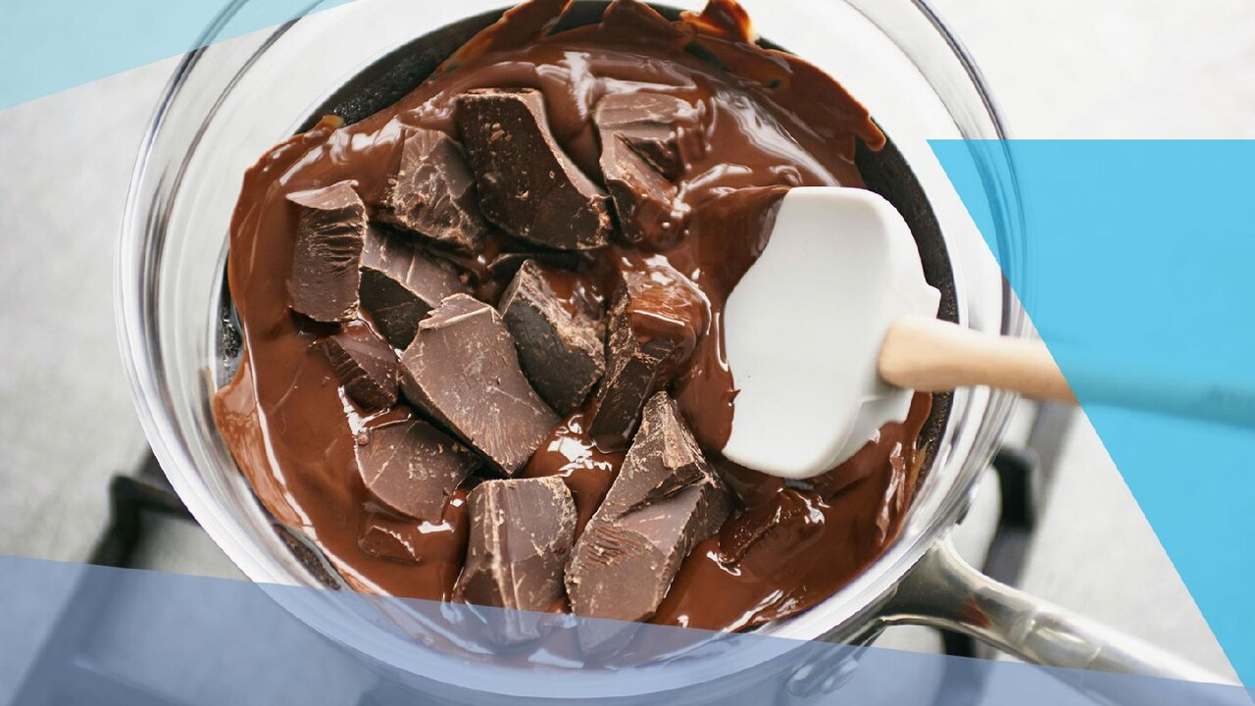
______________ the chocolate

Slide 7

______________ the cucumber

Slide 8
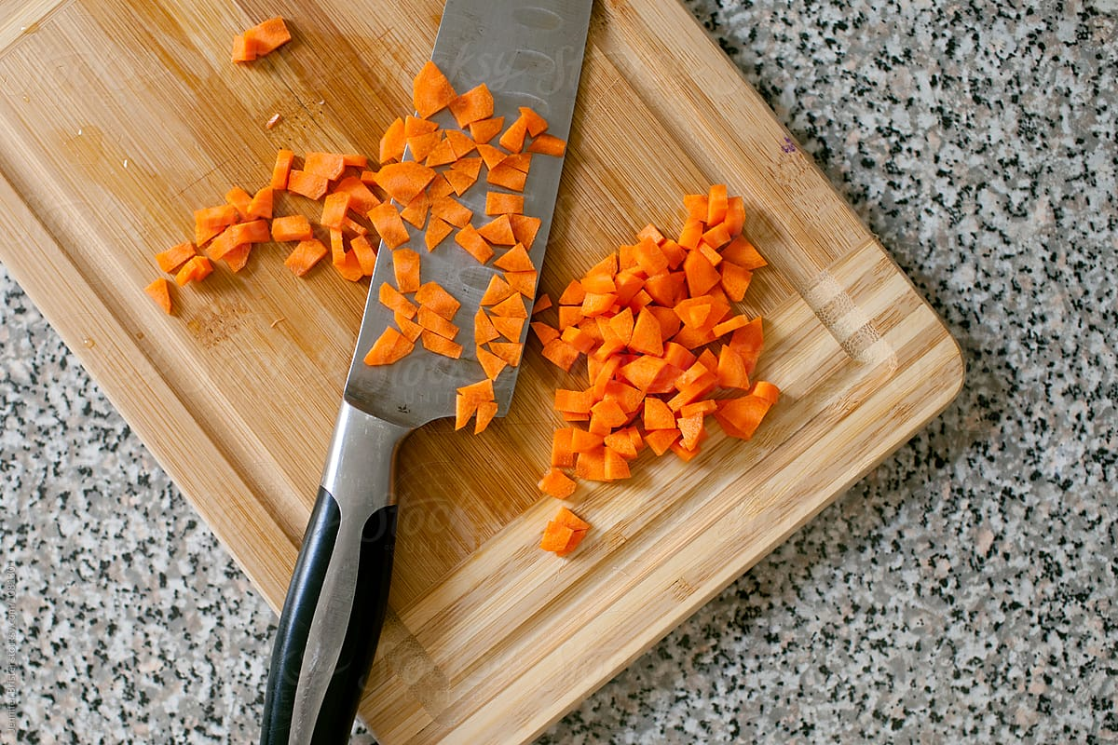
_____________ the carrot

Slide 9
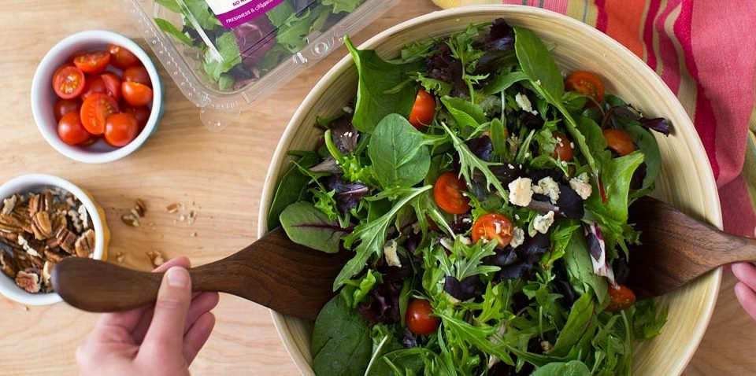
____________ the salad

Slide 10
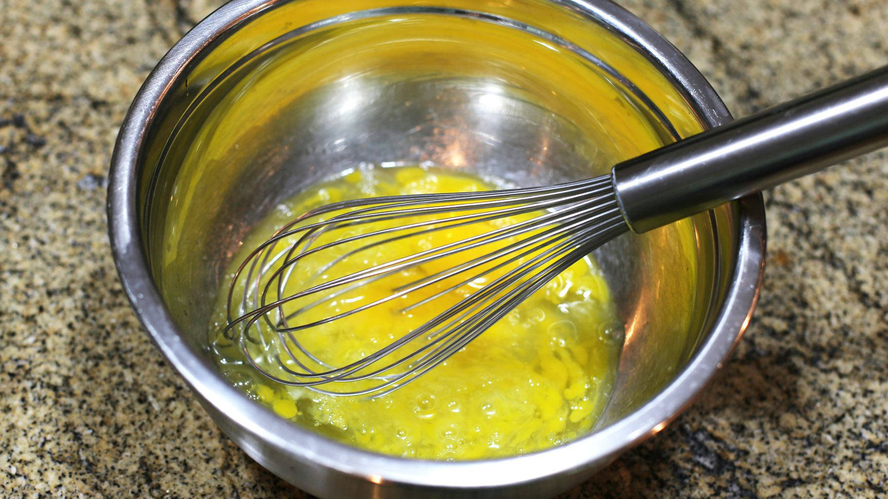
_____________ the eggs

Slide 11
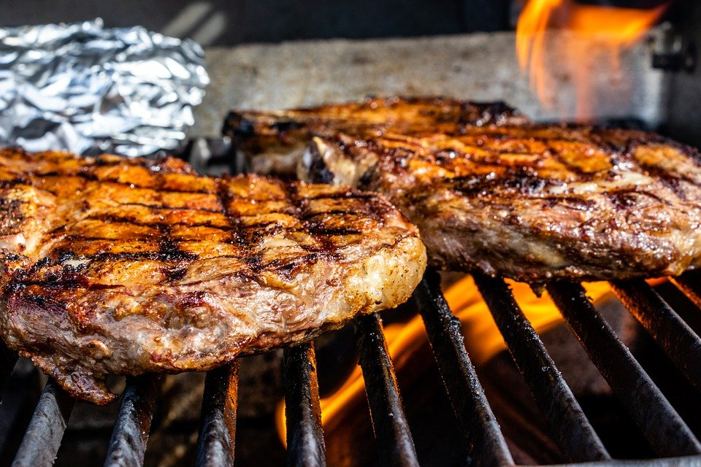
____________ meat

Slide 12
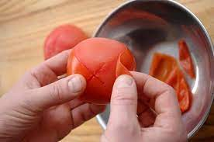
_____________ the tomato

Slide 13
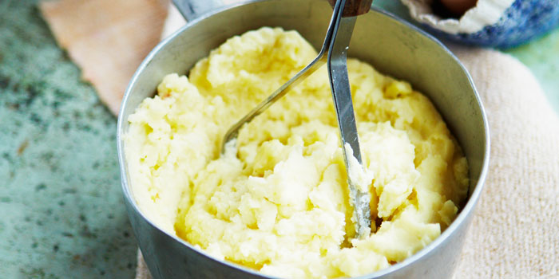
___________the potatoes

Slide 14
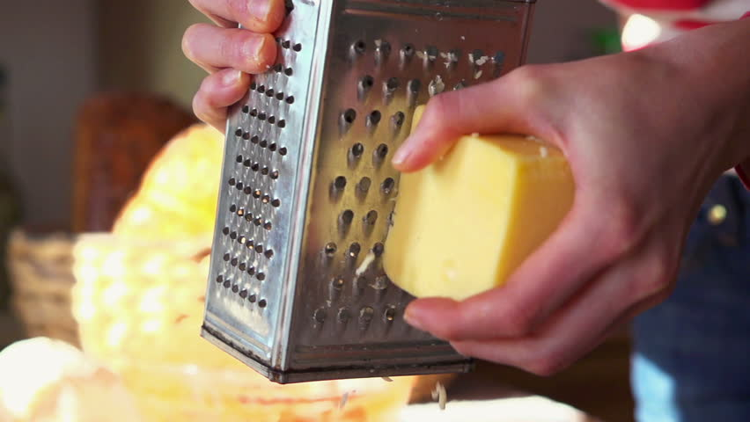
____________ cheese

